Slide 1
Nonparametric Statistics
SAS Version

Slide 2
What are nonparametric statistics?
Some erroneously suggest that nonparametric statistics have no assumptions. That is not true.
Some erroneously suggest that there are no statistical distributions involved in nonparametric statistics. That is misleading. Typically there is no assumption a specific distribution of the raw data. However, nonparametric statistics often rely upon standard distributions to compare their test statistic against.

Slide 3
Where is often a good place to deploy nonparametric statistics?
Population is not normal
Sample size is very small
Some data are ordinal
Samples could be dependent or independent depending upon the nonparametric test used

Slide 4
Where is often a good place to deploy nonparametric statistics?
Population is not normal
Sample size is very small
Some data are ordinal
Samples could be dependent or independent depending upon the nonparametric test used
Population median is typically used in nonparametric statistics
Median handy for blunting the impact of outliers

Slide 5
Wilcoxon Signed Rank Sum Test

Slide 6
Wilcoxon Signed Rank Sum Test
The Wilcoxon Signed Rank Test is the nonparametric equivalent of the parametric paired t test
Imagine that we have two drugs we are testing to see how many hours of relief each drug has. Note that this is a repeated measures test where each patient is tested for both drug A and drug B
Null hypothesis: m₁ = m₂
Alternative hypothesis: m₁ ≠ m₂

Slide 7
Wilcoxon Signed Rank Sum Test
Here is our data – there are 12 patients.
Case | Drug A | Drug B | Case | Drug A | Drug B
1 | 2.0 | 3.5 | 7 | 14.9 | 16.7
2 | 3.6 | 5.7 | 8 | 6.6 | 6.0
3 | 2.6 | 2.9 | 9 | 2.3 | 3.8
4 | 2.6 | 2.4 | 10 | 2.0 | 4.0
5 | 7.3 | 9.9 | 11 | 6.8 | 9.1
6 | 3.4 | 3.3 | 12 | 8.5 | 20.9

Slide 8
Wilcoxon Signed Rank Sum Test
Let’s compute the differences of Drug B – Drug A and then rank them. Note that there is one tied difference (1.5 hours).

Slide 9
Wilcoxon Signed Rank Sum Test
Let’s sum the negative ranks W- and then the positive ranks W+
+
W − = 1 + 2 + 4 = 7 and
W + = 3 + 5.5 + 5.5 + 7 + 8 + 9 + 10 + 11 + 12 = 71

Slide 10

Wilcoxon Signed Rank Sum Test
Want to check to make sure you didn’t mess up doing this?
+
W − = 1 + 2 + 4 = 7 and
W + = 3 + 5.5 + 5.5 + 7 + 8 + 9 + 10 + 11 + 12 = 71
W- added to W+ should be equal to the following:
So 7 + 71 = 78 = 12*(12+1)/2 =78 Yay!!!

Slide 11


Wilcoxon Signed Rank Sum Test
If we have at least n>10 then we can use a normal approximation to test our hypothesis.
Here is the approximation mean W
+
and here is the approximate standard deviation for W

Slide 12
Wilcoxon Signed Rank Sum Test
But of course we have that nasty tie with two ranks tied at 5.5
So we will need to subtract something from the standard deviation of W to compensate for that. In this case that “something” is
+
Where t is the number of ties at that rank. So if there are two 5.5 ranks then t=2. If there are three ties at that rank then t=3. You subtract this from inside the standard deviation square root each time you encounter a tie.

Slide 13



Wilcoxon Signed Rank Sum Test
So remembering that z = /
+
Note the 0.125 subtracted inside the pop standard deviation for the one tie!

Slide 14
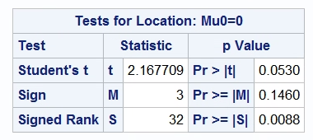
Wilcoxon Signed Rank Sum Test
So with Z = 2.511 which is > 1.96, we can reject the null hypothesis and state that there is a difference in the number of hours of pain relief between drug A and drug B. The p value for z=2.511 is about .0060, which is close. SAS is using an exact probability while we used the approximation to the z distribution.
Here is the SAS run for the data and we can see approximately the same result as by hand:
+

Slide 15
Wilcoxon Signed Rank Sum Test
data wilcoxon;
input patient druga drugb;
datalines;
1 2.0 3.5
2 3.6 5.7
3 2.6 2.9
4 2.6 2.4
5 7.3 9.9
6 3.4 3.3
7 14.9 16.7
8 6.6 6.0
9 2.3 3.8
10 2.0 4.0
11 6.8 9.1
12 8.5 20.9
;
run;
data diffy;
set wilcoxon;
drugdiff= drugb - druga;
run;
proc univariate data=diffy;
var drugdiff;
Exact Wilcoxon;
run;
+
Here is the SAS code for the test:

Slide 16
Mann Whitney Test

Slide 17
Mann Whitney Test
The Mann Whitney test is the nonparametric equivalent of the parametric t test
Imagine that we are investigating the age of onset of juvenile diabetes for males and females. Thus males and females are the two independent groups under examination.
Null hypothesis: m₁ = m₂
Alternative hypothesis: m₁ ≠ m₂

Slide 18
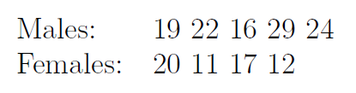
Mann Whitney Test
Here is our data…

Slide 19
Mann Whitney Test
Let’s order the ages for the entire group from low to high.
Then let’s identify their sex by marking them M or F
Next construct row U_{M}, label it M > F in the table and it describes how many females are below that male
Next construct row U_{F}, label it F > M in the table and it describes how many males are below that female
Adapted from https://www.statstutor.ac.uk/resources/uploaded/mannwhitney.pdf

Slide 20


Mann Whitney Test
We know the following for Mann Whitney test
So we can once again construct a simple Z score…

Slide 21
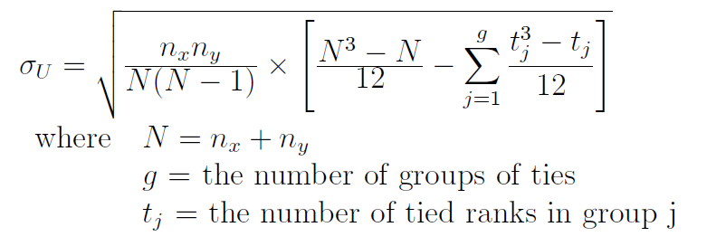
Mann Whitney Test
If there are any ties, then the standard deviation is adjusted as follows, with each tie getting subtracted in turn

Slide 22
Mann Whitney Test
First let’s calculate U_{M} and U_{F}
U_{M} = 2 + 3 + 4 + 4 + 4 = 17
U_{F} = 0 + 0 + 1 + 2 = 3

Slide 23
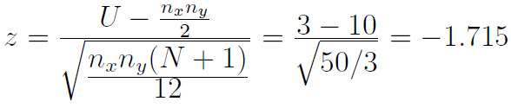
Mann Whitney Test
Now use the minimum of the two which is U_{F} which is 3, and apply it to our mean and standard deviation for U to get our z score
The p value for this is 0.09, so there is no evidence that males are different from females at age of onset of juvenile diabetes. However, this is a very small sample and because the median age for males is 22 and females is 14.5, a larger sample should be tested.

Slide 24
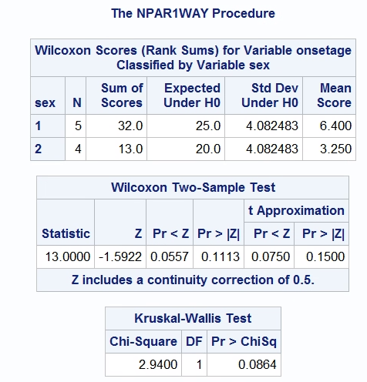
Mann Whitney Test
SAS provides us with the following, which compares closely with our p = .09 for our hand calculations…once again SAS is using exact probabilities while we are using the z approximation.

Slide 25
Mann Whitney Test
Here is the SAS code for our Mann Whitney test. Notice that Mann Whitney is also called the Wilcoxon test (without the Sign label, which is I know is somewhat confusing…)
data mannwhit;
input patient sex onsetage;
datalines;
1 1 19
2 1 22
3 1 16
4 1 29
5 1 24
6 2 20
7 2 11
8 2 17
9 2 12
;
run;
proc format;
value sex 1 'male' 2 'female';
proc npar1way data=mannwhit wilcoxon;
class sex;
var onsetage;
run;

Slide 26
Kruskall Wallis Test

Slide 27
Kruskall Wallis Test
The Kruskall Wallis test is the nonparametric equivalent of the parametric Oneway ANOVA test
Here are the null and alternative hypotheses:
Null hypothesis: all the medians are equal
Alternative hypothesis: at least one median is different from at least one other median

Slide 28
Kruskall Wallis Test
Here is our data – salaries in thousands of dollars for three separate independent groups of people
Women | Men | Minorities
23 | 45 | 18
41 | 55 | 30
54 | 60 | 34
66 | 70 | 40
78 | 72 | 44

Slide 29
Kruskall Wallis Test
Order all the data and rank them…
20 1
23 2
30 3
34 4
40 5
41 6
44 7
45 8
54 9
55 10
60 11
66 12
70 13
72 14
90 15

Slide 30
Kruskall Wallis Test
Order all the data and rank them…
Women: 23, 41, 54, 66, 90 = 2 + 6 + 9 + 12 + 15 = 44
Men: 45, 55, 60, 70, 72 = 8 + 10 + 11 + 13 + 14 = 56
Minorities: 20, 30, 34, 40, 44 = 1 + 3 + 4 + 5 + 7 = 20

Slide 31
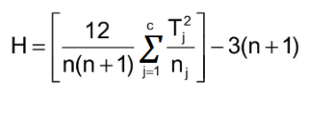
Kruskall Wallis Test
Here is the formula – it’s a bit messy and does not account for ties, which is even messier…
n = sum of sample sizes for all samples,
c = number of samples,
Tj = sum of ranks in the jth sample,
nj = size of the jth sample.

Slide 32


Kruskall Wallis Test
Let’s just skip to the test using SAS…here is the data set
H = 6.72

Slide 33
Kruskall Wallis Test
The H test statistic is chi square distributed with the degrees of freedom = number of groups -1 = 3 -1 =2
So our chi square table says the critical value for df=2 and alpha=.05 is =5.99

Slide 34
Kruskall Wallis Test
Our H test statistic from the data = 6.72 and our chi square critical value is 5.99
So we can reject the null hypothesis that all the medians are equal and accept the alternative hypothesis that at least one media is different from at least one other median

Slide 35
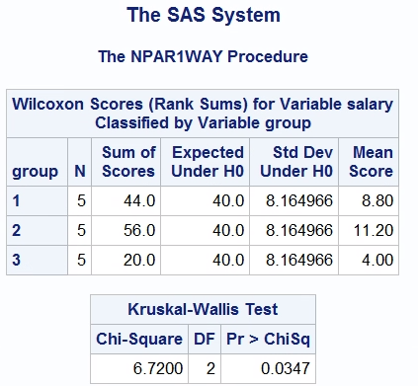
Kruskall Wallis Test
Here we see that our H=6.72 from our hand calculation agrees with the SAS analysis…

Slide 36
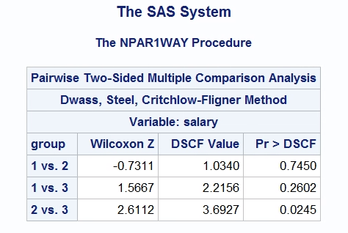
Kruskall Wallis Test
You can also do a multiple group comparison test to see which groups are different from which. We can see that the median for group 2 is different from group 3.

Slide 37
Kruskall Wallis Test
Here is our SAS code for the analysis…
If you want to get a multiple group comparison test, just add DSCF right after the data=kruskallw. Note that you only get the multiple group comparison test output, so do the Kruskall Wallis first to test for overall significance
data kruskallw;
input personid group salary;
datalines;
1 1 23
2 1 41
3 1 54
4 1 66
5 1 78
6 2 45
7 2 55
8 2 60
9 2 70
10 2 72
11 3 18
12 3 30
13 3 34
14 3 40
15 3 44
;
run;
proc format;
value groupo 1 'men' 2 'women' 3 'minorities';
proc npar1way data=kruskallw DSCF;
Format group groupo.;
class group;
var salary;
run;

